Slide 3
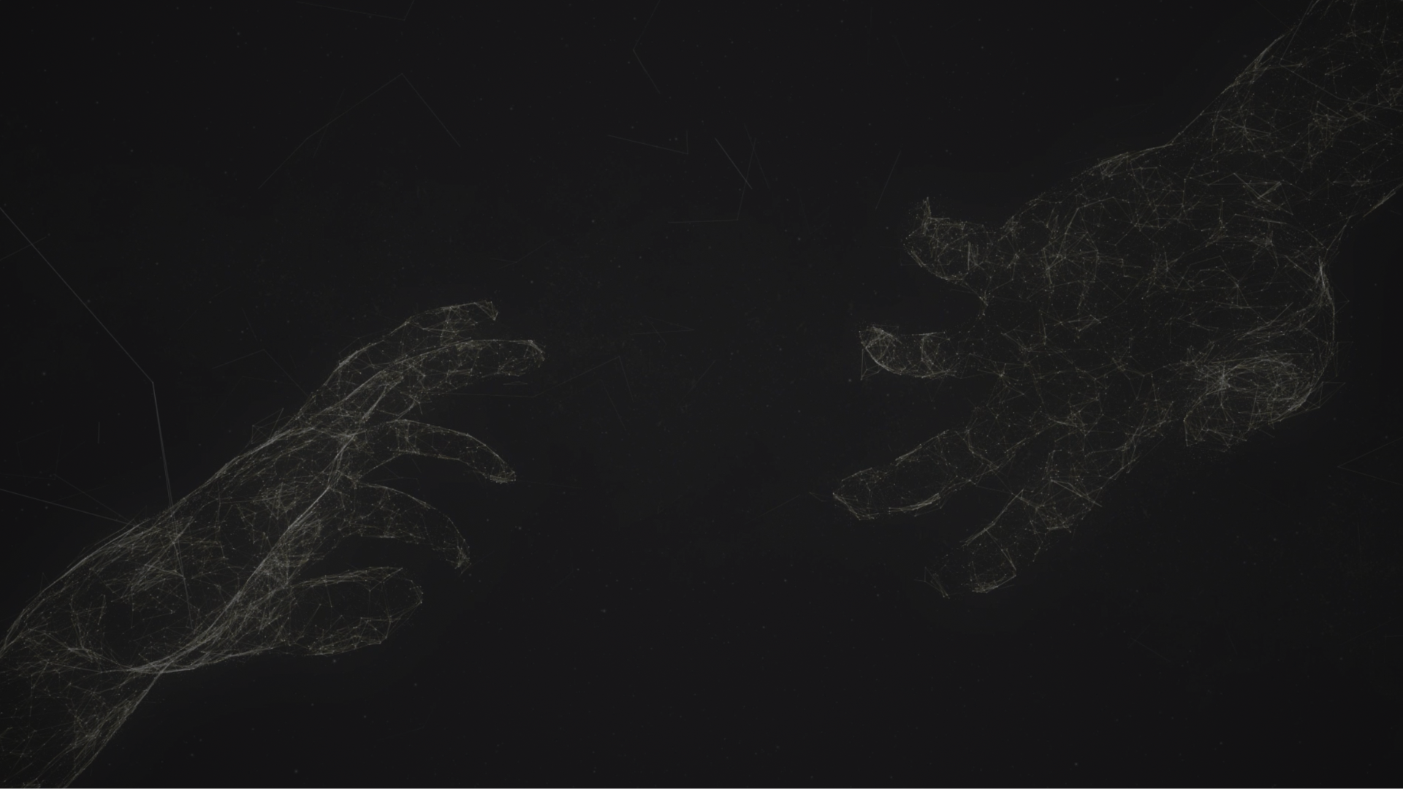
Colossians 4:5-6
Walk in wisdom toward outsiders, making the best use of the time.
Let your speech always be gracious, seasoned with salt, so that you may know how you ought to answer each person.

Slide 4
Colossians 3:1
If then you have been raised with Christ,
seek the things that are above,

Slide 5
Colossians 3:1
If then you have been raised with Christ,
seek the things that are above,
3:5-11 Purity in life

Slide 6
Colossians 3:1
If then you have been raised with Christ,
seek the things that are above,
3:5-11 Purity in life
3:12-17 Unity in church

Slide 7
Colossians 3:1
If then you have been raised with Christ,
seek the things that are above,
3:5-11 Purity in life
3:12-17 Unity in church
3:18-4:1 Order in household

Slide 8
Colossians 3:1
If then you have been raised with Christ,
seek the things that are above,
3:5-11 Purity in life
3:12-17 Unity in church
3:18-4:1 Order in household
4:2-4 Faithfulness in prayer

Slide 9
Colossians 3:1
If then you have been raised with Christ,
seek the things that are above,
3:5-11 Purity in life
3:12-17 Unity in church
3:18-4:1 Order in household
4:2-4 Faithfulness in prayer
4:5-6 Wisdom and graciousness in testimony

Slide 10
Colossians 3:1
If then you have been raised with Christ,
seek the things that are above,
3:5-11 Purity in life
3:12-17 Unity in church
3:18-4:1 Order in household
4:2-4 Faithfulness in prayer
4:5-6 Wisdom and graciousness in testimony

Slide 11
GOSPEL LIGHT SHINE!
Colossians 4:5-6

Slide 12
1. GOSPEL-CENTRED LIFE

Slide 13
1. GOSPEL-CENTRED LIFE
Walk in wisdom toward outsiders

Slide 14
1. GOSPEL-CENTRED LIFE
Walk in wisdom toward outsiders

Slide 15
1. GOSPEL-CENTRED LIFE
Walk in wisdom toward outsiders
Colossians 1:9–10
… walk in a manner worthy of the Lord, fully pleasing to him: bearing fruit in every good work and increasing in the knowledge of God;

Slide 16
1. GOSPEL-CENTRED LIFE
Walk in wisdom toward outsiders
Colossians 2:6–7
Therefore, as you received Christ Jesus the Lord, so walk in him, rooted and built up in him…

Slide 17
1. GOSPEL-CENTRED LIFE
Walk in wisdom toward outsiders
Colossians 3:7
In these you too once walked, when you were living in them.

Slide 18
1. GOSPEL-CENTRED LIFE
Walk in wisdom toward outsiders

Slide 19
1. GOSPEL-CENTRED LIFE
Walk in wisdom toward outsiders

Slide 20
1. GOSPEL-CENTRED LIFE
Walk in wisdom toward outsiders
Colossians 1:9
… asking that you may be filled with the knowledge of his will in all spiritual wisdom and understanding,

Slide 21
1. GOSPEL-CENTRED LIFE
Walk in wisdom toward outsiders
Colossians 1:28
Him we proclaim, warning everyone and teaching everyone with all wisdom, that we may present everyone mature in Christ.

Slide 22
1. GOSPEL-CENTRED LIFE
Walk in wisdom toward outsiders
Colossians 2:2–3
…Christ, in whom are hidden all the treasures of wisdom and knowledge.

Slide 23
1. GOSPEL-CENTRED LIFE
Walk in wisdom toward outsiders

Slide 24
1. GOSPEL-CENTRED LIFE
Our Witness often begins with our Walk

Slide 25
1. GOSPEL-CENTRED LIFE
KNOW→ GROW→ GO

Slide 26
1. GOSPEL-CENTRED LIFE
Walk in wisdom toward outsiders

Slide 27
1. GOSPEL-CENTRED LIFE

Slide 28
2. GRABBING IN LOVE

Slide 29
2. GRABBING IN LOVE
making the best use of the time.

Slide 30
Video

Slide 31
2. GRABBING IN LOVE
making the best use of the time.

Slide 32
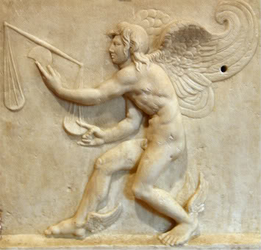

Slide 33
Why do you stand on tip-toe?

Slide 34
Why do you stand on tip-toe?
I am ever running.

Slide 35
And why you have a pair of wings on your feet?

Slide 36
And why you have a pair of wings on your feet?
I fly away swiftly with the wind.

Slide 37
And why does your hair hang over your face?

Slide 38
And why does your hair hang over your face?
For him to seize me by the forelock when I come.

Slide 39
And why is the back of your head bald?

Slide 40
And why is the back of your head bald?
That when I’m gone, none can lay hold of me.

Slide 41
2. GRABBING IN LOVE
making the best use of the time.

Slide 42
3. GRACIOUS WITH OUR LIPS

Slide 43
3. GRACIOUS WITH OUR LIPS
Let your speech always be gracious, seasoned with salt, so that you may know how you ought to answer each person.

Slide 44
3. GRACIOUS WITH OUR LIPS
Let your speech always be gracious, seasoned with salt, so that you may know how you ought to answer each person.
1 Peter 3:15 always being prepared to make a defense to anyone who asks you … yet do it with gentleness and respect

Slide 45
3. GRACIOUS WITH OUR LIPS
Let your speech always be gracious, seasoned with salt, so that you may know how you ought to answer each person.

Slide 46
3. GRACIOUS WITH OUR LIPS
Let your speech always be gracious, seasoned with salt, so that you may know how you ought to answer each person.

Slide 47
Colossians 3:1
If then you have been raised with Christ,
seek the things that are above,

Slide 48
Colossians 3:1
If then you have been raised with Christ,
seek the things that are above,
3:5-11 Purity in life

Slide 49
Colossians 3:1
If then you have been raised with Christ,
seek the things that are above,
3:5-11 Purity in life
3:12-17 Unity in church

Slide 50
Colossians 3:1
If then you have been raised with Christ,
seek the things that are above,
3:5-11 Purity in life
3:12-17 Unity in church
3:18-4:1 Order in household

Slide 51
Colossians 3:1
If then you have been raised with Christ,
seek the things that are above,
3:5-11 Purity in life
3:12-17 Unity in church
3:18-4:1 Order in household
4:2-4 Faithfulness in prayer

Slide 52
Colossians 3:1
If then you have been raised with Christ,
seek the things that are above,
3:5-11 Purity in life
3:12-17 Unity in church
3:18-4:1 Order in household
4:2-4 Faithfulness in prayer
4:5-6 Wisdom and graciousness in testimony

Slide 53
Colossians 3:1
If then you have been raised with Christ,
seek the things that are above,
3:5-11 Purity in life
3:12-17 Unity in church
3:18-4:1 Order in household
4:2-4 Faithfulness in prayer
4:5-6 Wisdom and graciousness in testimony

Slide 54
1. GOSPEL-CENTRED IN LIFE

Slide 55
1. GOSPEL-CENTRED IN LIFE
2. GRABBING IN LOVE

Slide 56
1. GOSPEL-CENTRED IN LIFE
2. GRABBING IN LOVE
3. GRACIOUS WITH OUR LIPS

Slide 57
GOSPEL LIGHT SHINE!
1. GOSPEL-CENTRED IN LIFE
2. GRABBING IN LOVE
3. GRACIOUS WITH OUR LIPS

